Slide 1

Electrical and Electronic Engineering Principles 1
UWEBIC IY424
Mohammad Hosseinabady
Quiz
mohammad@highlevel-synthesis.com

Slide 2
1. The joule is the unit for ___.
a. energy b. charge c. time d. frequency
Answer: a

Slide 3
2. The ___ is the unit for resistance, reactance, and impedance.
a. farad b. henry c. ohm d. watt
Answer: c

Slide 4
3. The number 0.0136 equals 13.6 × ___.
a. 10^{–1} b. 10^{–2} c. 10^{–3} d. 10^{–4}
Answer: c

Slide 5
4. The number 5200 ×10^{–2} equals ___ × 10¹.
a. 0.52 b. 5.2 c. 52 d. 520
Answer: b

Slide 6
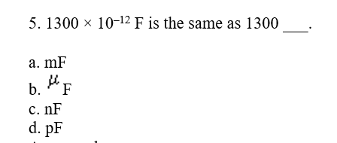
Answer: d

Slide 7
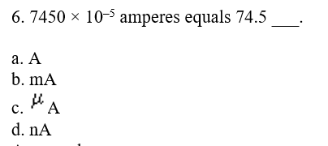
Answer: b

Slide 8
7. 106,100,000 Hz is the same as ___ MHz.
a. 106.1 b. 1,061 c. 10,610 d. 106,100
Answer: a

Slide 9
8. (12.6 × 10⁶)(10.5 × 10³) = ________.
a. 13.2 × 10¹² b. 1.32 × 10¹² c. 1.32 × 10¹¹ d. 13.2 × 10¹¹
Answer: c

Slide 10
9. Moving the decimal point three places to the right is the same as multiplying by ________.
Answer: 1,000

Slide 11
10. Moving the decimal point five places to the left is the same as dividing by ________.
Answer: 100,000

Slide 12
11. Multiplying the metric prefix "kilo" by the metric prefix “micro” gives the metric prefix ________.
Answer: milli

Slide 13
12. Dividing the metric prefix "milli" by the metric prefix "mega" gives the metric prefix ________.
Answer: nano

Slide 14
13. Deviation between a measured value and the accepted true value is known as ________.
Answer: error

